Slide 1
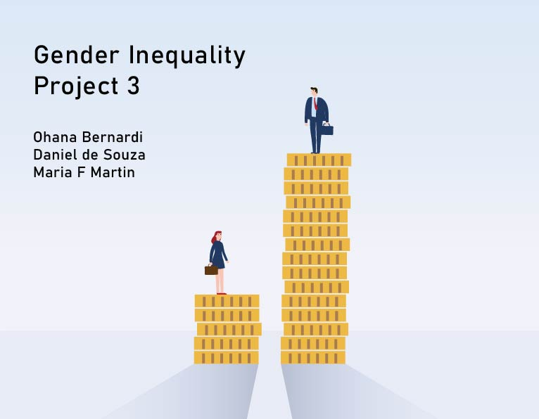

Slide 2

Examining gender inequality in different countries through the lens of Human Development Index

Slide 3
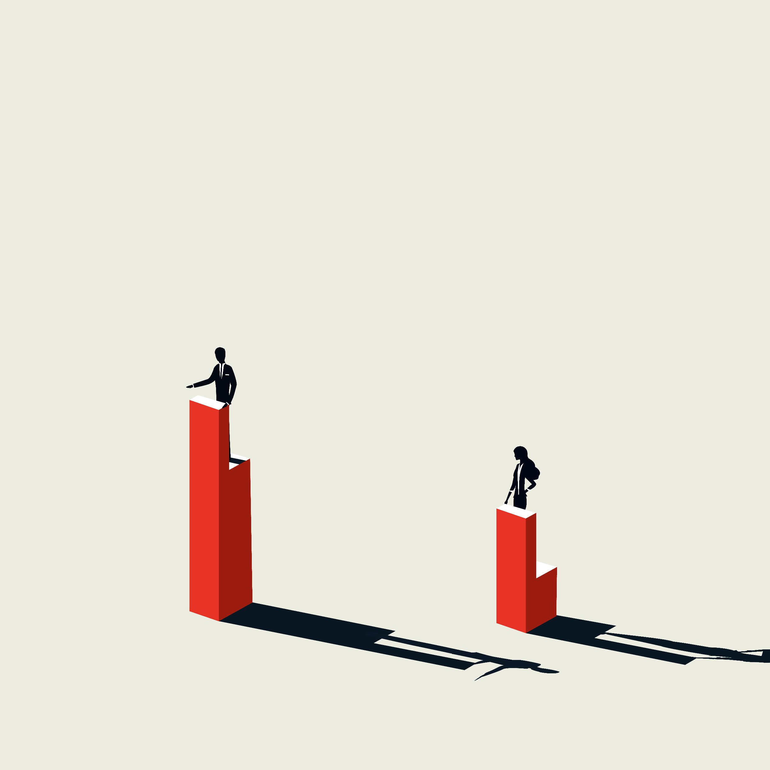
Human development is about giving people more freedom and opportunities to live lives they value. In effect this means developing people’s abilities and giving them a chance to use them. For example, educating a girl would build her skills, but it is of little use if she is denied access to jobs, or does not have the skills for the local labor market.

Slide 4
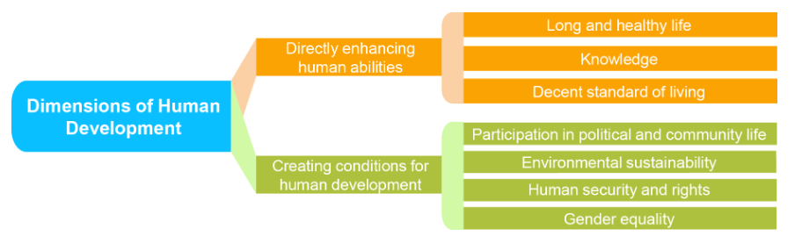

Slide 5

TOPIC SELECTION
Review different data sources
Brainstorming
Create a proposal using a data set from Kaggel
Webpage and Visualizations
Using HTML, CSS and JavaScript for our webpage and dashboards visualisation
ETL process
Transform/clean and load data using Python/Pandas
Web scraping and word cloud
Flask as our host for webpage

Slide 6
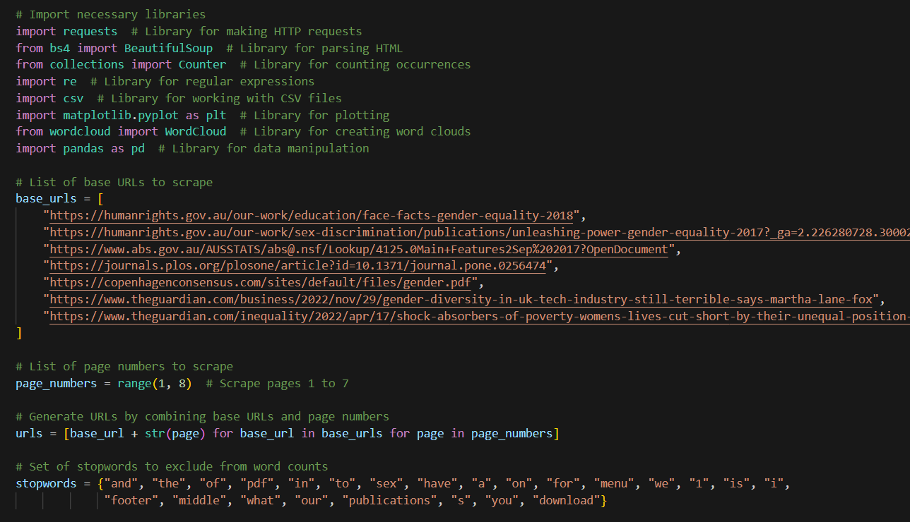

Slide 7

Web Scraping using Beautiful Soup, matplotlib & Word Cloud Library

Slide 8
Dataset Description:
HDI Rank - Human Development Index Rank:
Represents the Human Development Index (HDI) Rank for each country. This rank indicates the country's relative position compared to other nations worldwide in terms of human development.
Country:
Displays the name of the country for which the data is recorded.
Human Development:
A comprehensive measure that quantifies a country's overall well-being and development status, considering key factors such as health, education, and economic indicators. The Human Development is categorized into five levels: very high, high, medium, low, and other.
Share of Female Seats in Parliament:
Shows the percentage of seats in the national parliament held by women. This indicator measures the level of gender representation in the political decision-making process. For countries with a bicameral legislative system, the share of seats is calculated based on both houses.
Female Education %:
Displays the percentage of females aged 25 and older who have reached at least some secondary education.
Male Education %:
Displays the percentage of males aged 25 and older who have reached at least some secondary education.
Female in Workforce %:
Represents the percentage of females in the total labor force of the country. This indicator shows the level of women's participation in the workforce.
Male in Workforce %:
Represents the percentage of males in the total labor force of the country. This indicator shows the level of men's participation in the workforce.

Slide 9
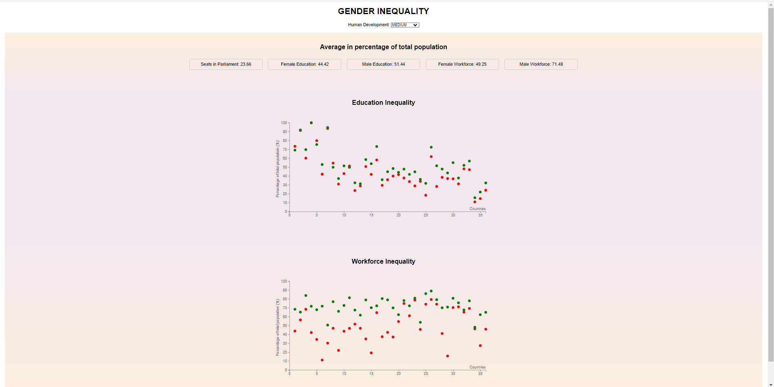

Slide 10
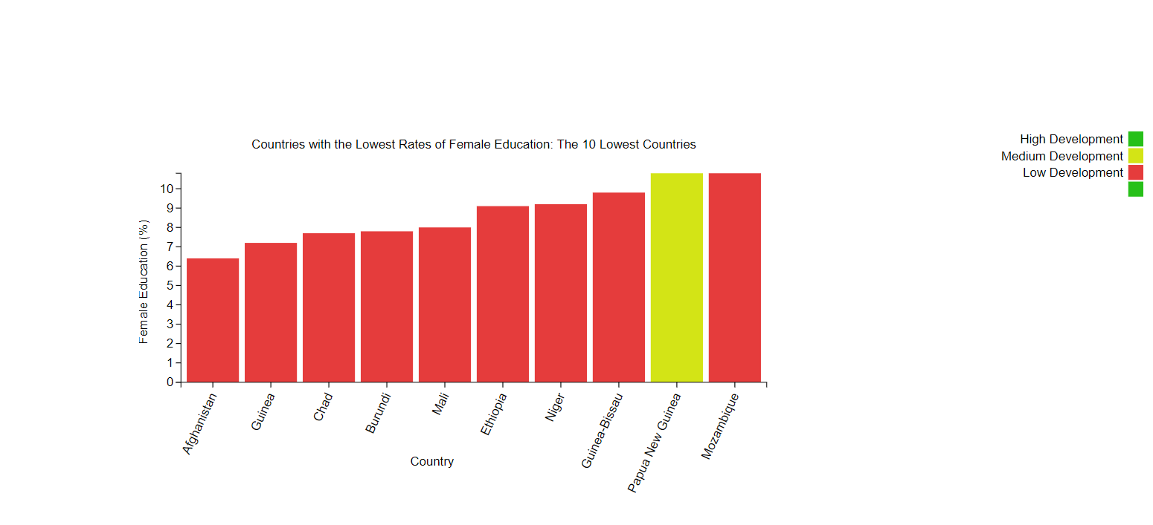

Slide 11
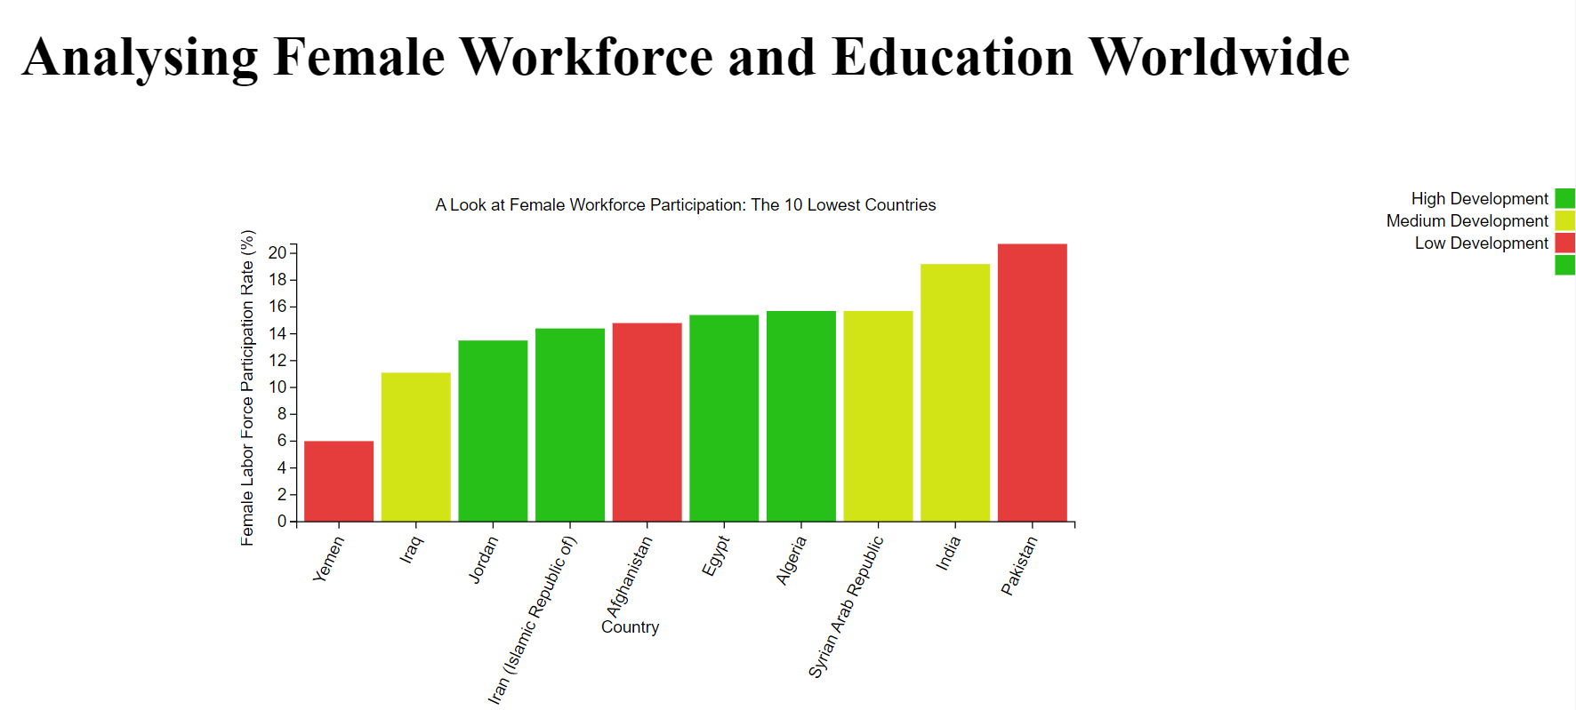

Slide 12

Conclusions:
Correlation between human development and inequality
This finding suggests that as a country's Human Development Index (HDI) increases, inequalities in education, workforce participation, and representation in parliament may decrease. However, correlation does not imply causation, so it would be worthwhile to investigate whether improvements in HDI are causing these reductions in inequality, or if there is another factor influencing both variables.
Differences in workforce participation across regions
The analysis indicates that countries in the Middle East have lower female workforce participation rates. Cultural beliefs and practices may be a significant factor in this trend.
Discrepancy between female workforce participation and overall development
This highlights the complexity of gender inequality and human development, where it's possible for a country to have relatively high levels of development while still experiencing significant Inequality between genders. Jordan, Iran, Egypt, and Algeria demonstrate relatively high levels of development despite low female workforce participation rates. This suggests that even countries with higher HDIs may need to focus specifically on gender-based policies to improve equality.
Overall Conclusion
In summary, our journey towards achieving gender equality still has a long way to go.

